Slide 1

AI Automated fraud DETECTION Dashboard
Objective of the project: Detect and prevent fraudulent transactions automatically
Tools Used : n8n, Supabase, Google Sheets, Quadratic, Looker Studio
Presented By : Sandra Raj P

Slide 2
Project description
The AI Automated Fraud Detection System is designed to identify and prevent fraudulent transactions in real-time by combining automation, cloud databases, machine learning, and interactive reporting. Using n8n, the system automates workflows to collect and preprocess transaction data from multiple sources, including Google Sheets and Supabase, ensuring that data is clean, standardized, and ready for analysis without manual intervention.
A Quadratic-based machine learning model analyzes transactions to predict the likelihood of fraud, effectively handling imbalanced datasets and improving accuracy. By evaluating key features such as transaction amount, type, location, and account history, the system prioritizes high-risk transactions for further review. This predictive capability enables organizations to act proactively, reducing potential financial loss and operational risk.
The processed results are visualized in real-time through Looker Studio dashboards, providing clear insights into trends, high-risk accounts, and transaction patterns. Alerts and notifications further enhance responsiveness, making the system scalable and efficient for continuous monitoring. Overall, this project streamlines fraud detection, improves decision-making, and strengthens financial security for businesses.

Slide 3
overview
Project Workflow integrates automation, database, AI, and visualization tools
Flow Diagram:
Data Source: Google Sheets / Supabase Database
Automation: n8n workflows to fetch, preprocess, and trigger analysis
AI Model: Quadratic algorithm / ML model for fraud prediction
Visualization & Reporting: Looker Studio dashboard
Alerting: Notifications for high-risk transactions

Slide 4
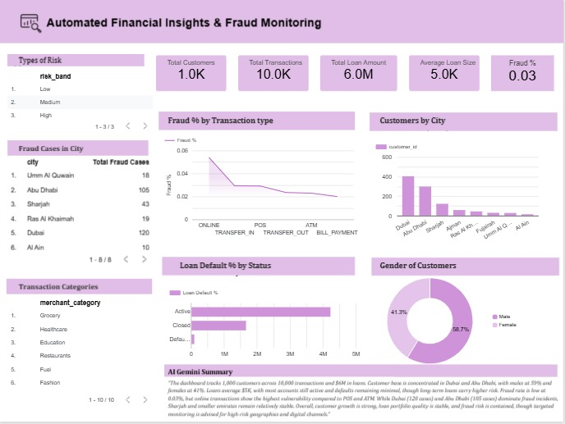
Dashboard
AI Gemini Insights for Fraud Monitoring

Slide 5
Data & Methodology
1. Data Collection & Storage
2. Data Preprocessing with n8n
Supabase: Store structured transaction data
Google Sheets: Input from various sources / manual corrections
Benefits: Centralized data, real-time updates
Automated workflows for:
Cleaning missing values
Filtering suspicious transactions
Transforming and standardizing data
Benefits: No manual intervention, real-time pipelines

Slide 6
3. AI Model (Quadratic )
Model predicts fraud probability for each transaction
Features: Transaction amount, type, location, account age, past history
Quadratic / ML optimization to improve accuracy & recall
Handles imbalanced dataset effectively

Slide 7
Dashboard Features
Visualizations:
Fraud % transaction type
Loan default % by Status
Fraud cases in cities
High-risk account alerts
Real-time updates from n8n → Supabase → Looker Studio

Slide 8
INSIGHTS
Total Customers: $1.12M
Avg Loan Size: $118
Total Transactions : 449% (high, needs retention strategies)
Total Loan Amount : 2124
Fraud Percentage :
Fraud levels remain low (0.03%), but cases cluster in Dubai & Abu Dhabi; online transactions show highest fraud risk."

Slide 9
RECOMMENDATIONS
Implement real-time fraud detection system
Monitor high-risk transactions continuously
Update model periodically with new data
Use dashboard for decision-making

Slide 10
CONCLUSION
Achieved high accuracy in detecting fraudulent transactions
Reduced potential financial loss
Can scale to handle real-time detection

Slide 11
Thank YOU
Email –sandraraj36@gmail.com LinkedIn – www.linkedin.com/in/sandrarajp Github - https://github.com/sandrarajp

